Slide 1
Trading Technologies XTrader Screenshots
Ben Lackey

Slide 2

XTrader Main Toolbar

Slide 3
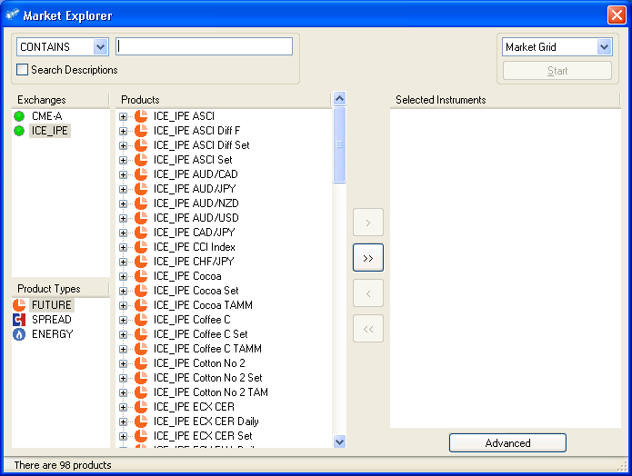
Market Explorer

Slide 4
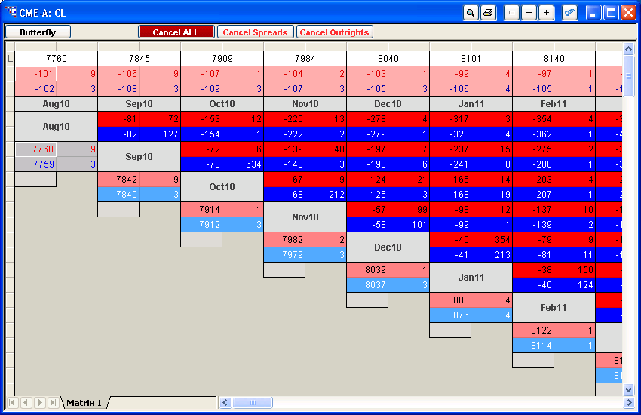
Spread Matrix

Slide 5
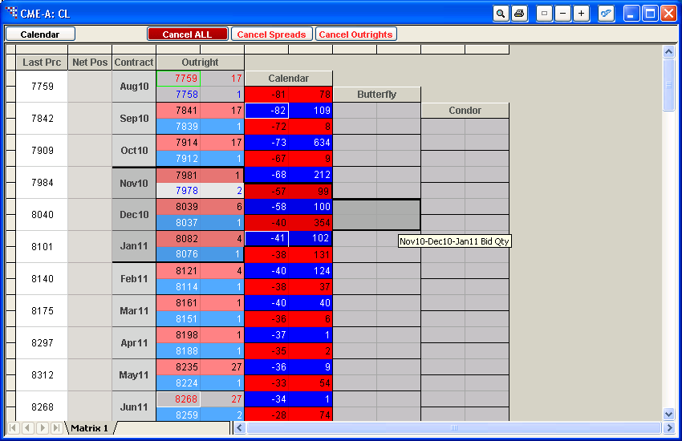

Slide 6
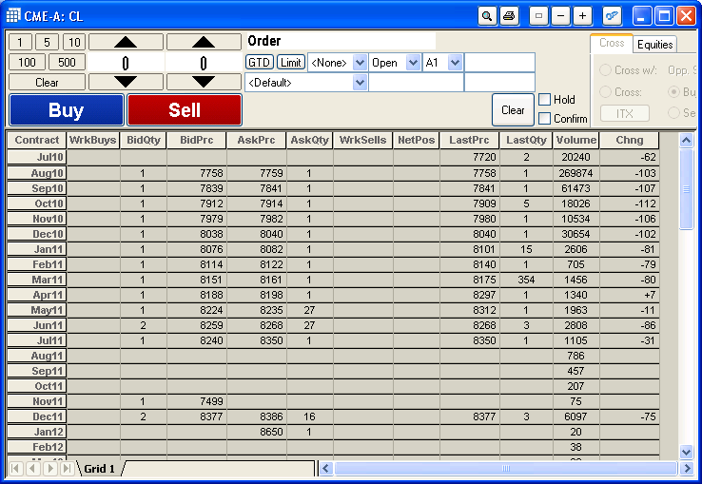
Market Grid

Slide 7
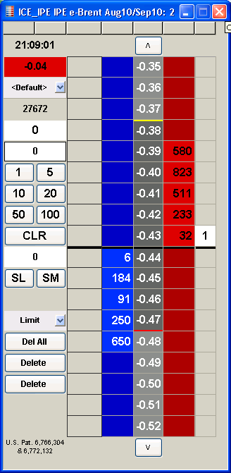
MD Trader

Slide 8
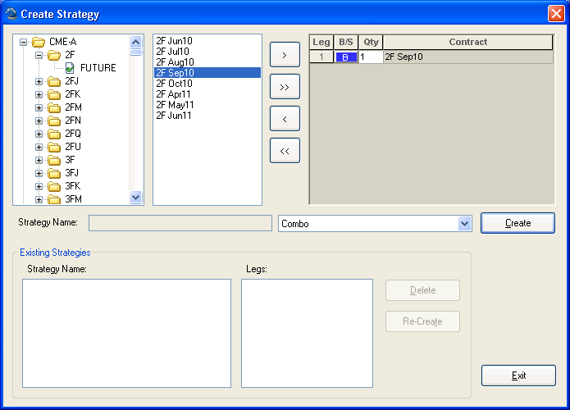
Create Strategy

Slide 9
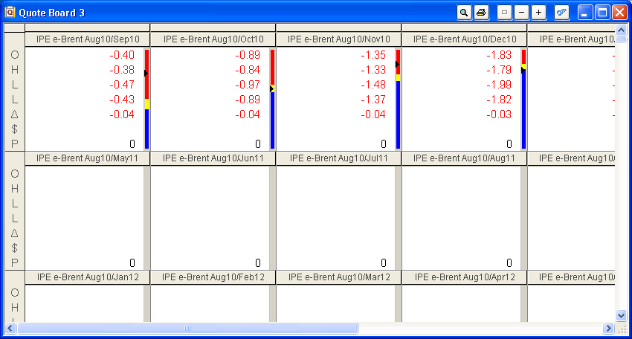
Quote Board

Slide 10
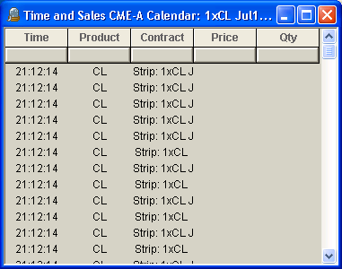
Time and Sales

Slide 11
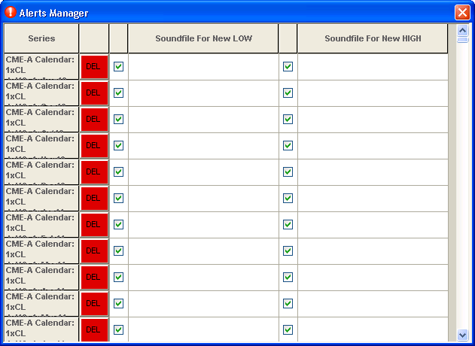
Alerts Manager

Slide 12
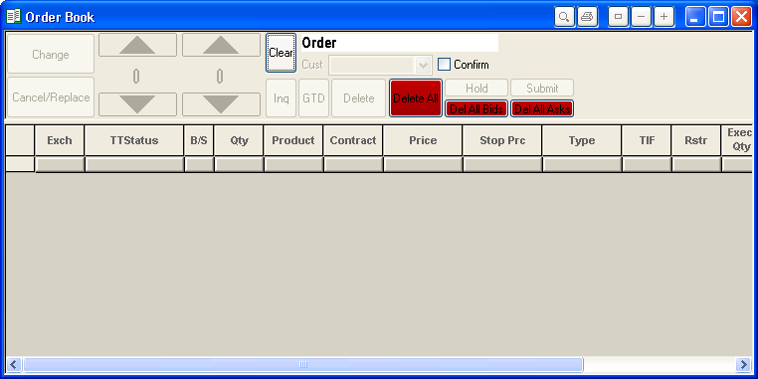
Order Book

Slide 13
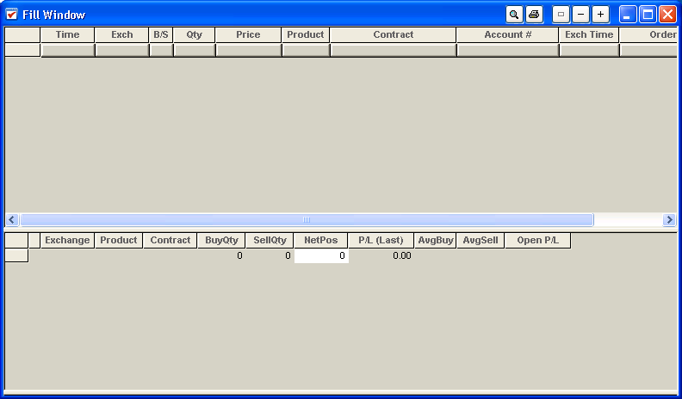
Fill Window

Slide 14
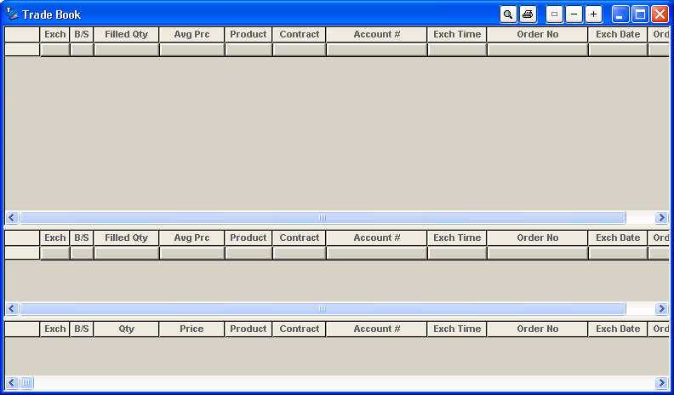
Trade Book

Slide 15
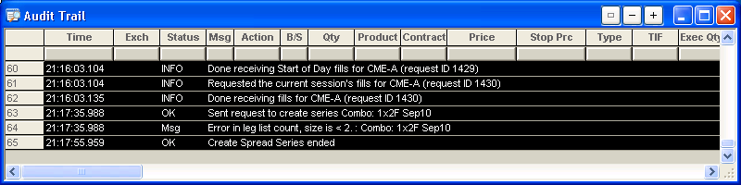
Audit Window

